Slide 1

WEEKLY #4 PRESENTATION
Pre class DumbWays Batch-28
http://www.free-powerpoint-templates-design.com

Slide 2
Presentation Point
01
Node JS and Express JS
Set up and use some dependencies
02
Styling Using EJS
Show output, EJS layout, and Javascript expression
03
Integrate to MySQL
Set up and show result in EJS

Slide 3
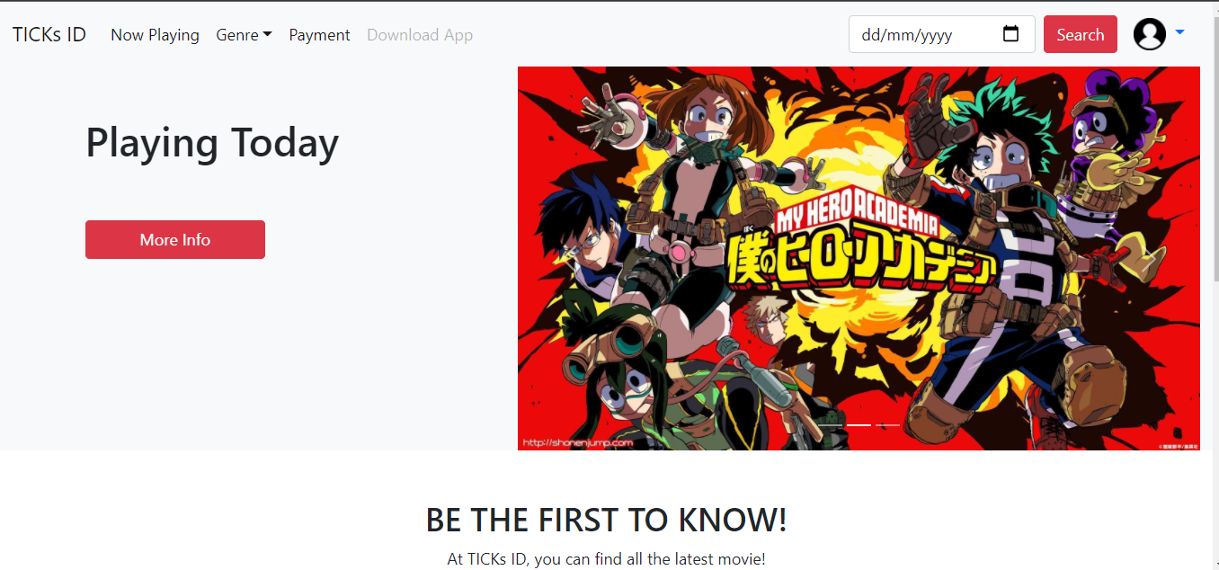

Slide 4
Node and Express JS

Slide 5
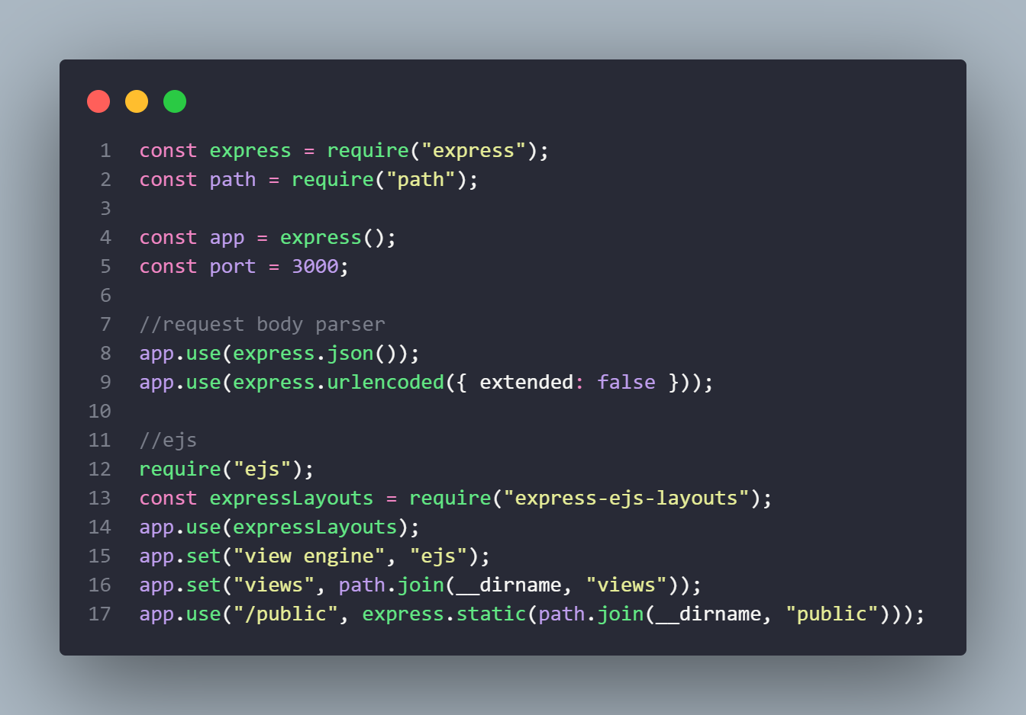
(1) Set up express, body parser, and ejs

Slide 6
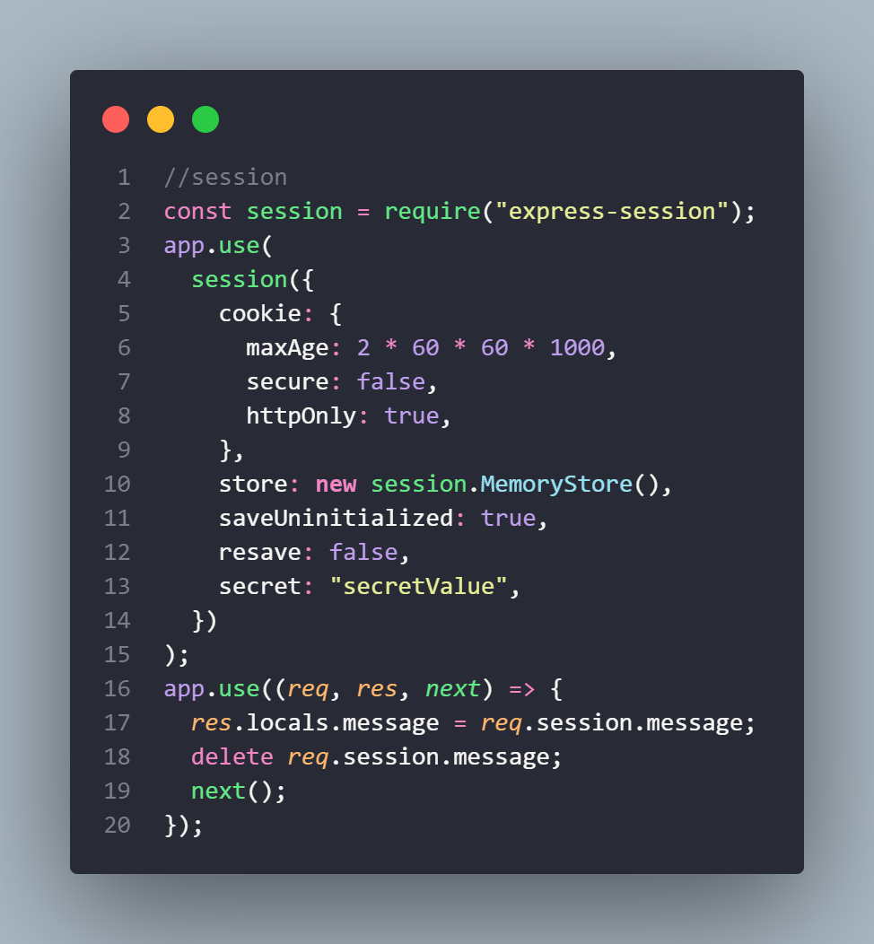
(1) Set up session

Slide 7
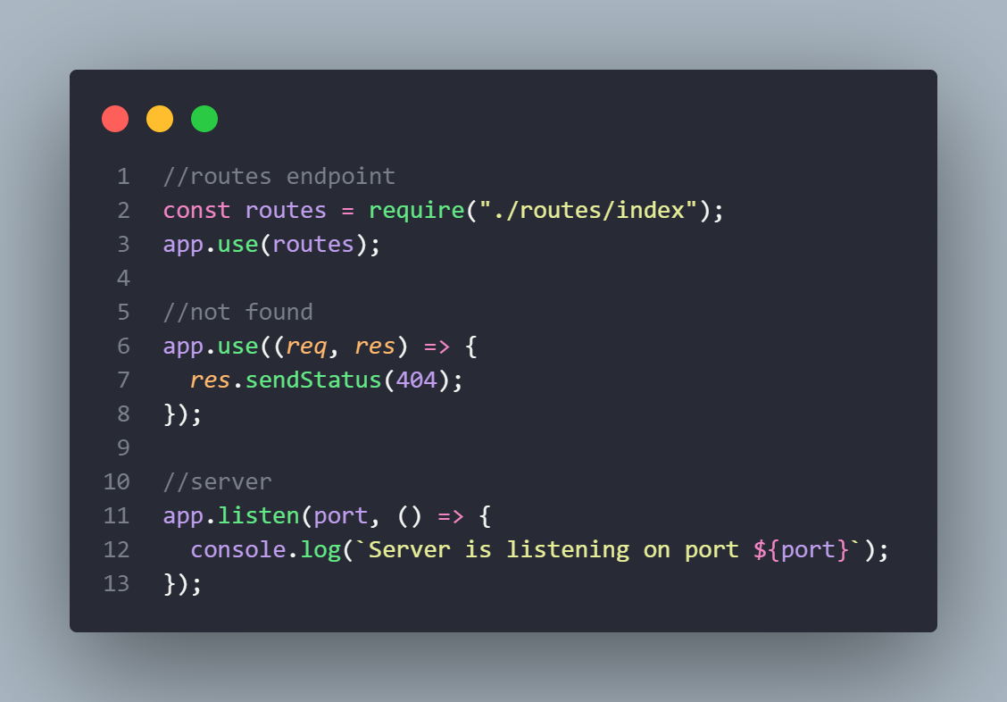
(1) Another set up

Slide 8
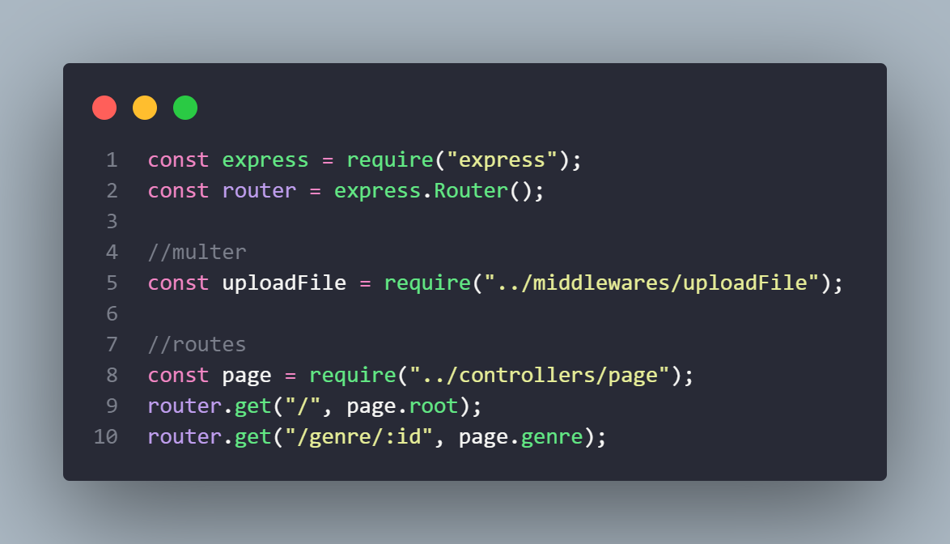
(2) Set up express.Router()

Slide 9
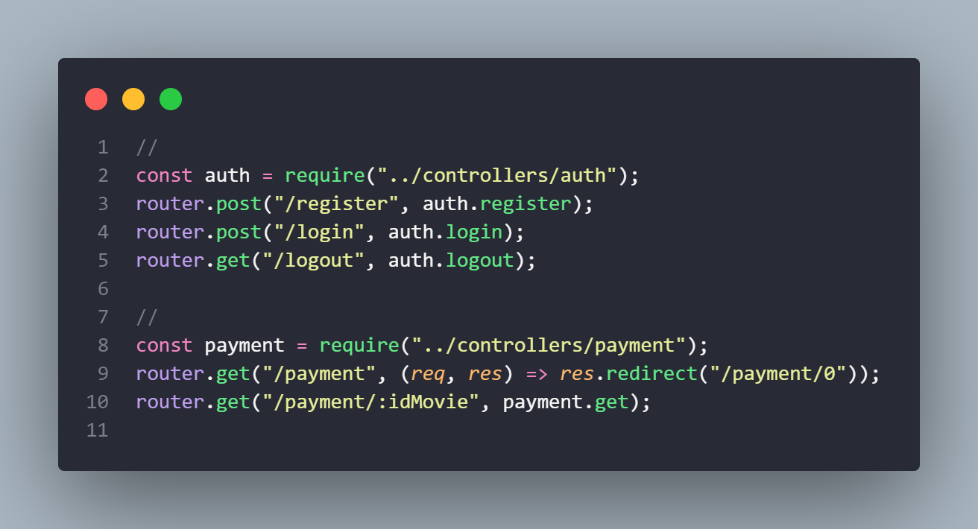
(2)

Slide 10
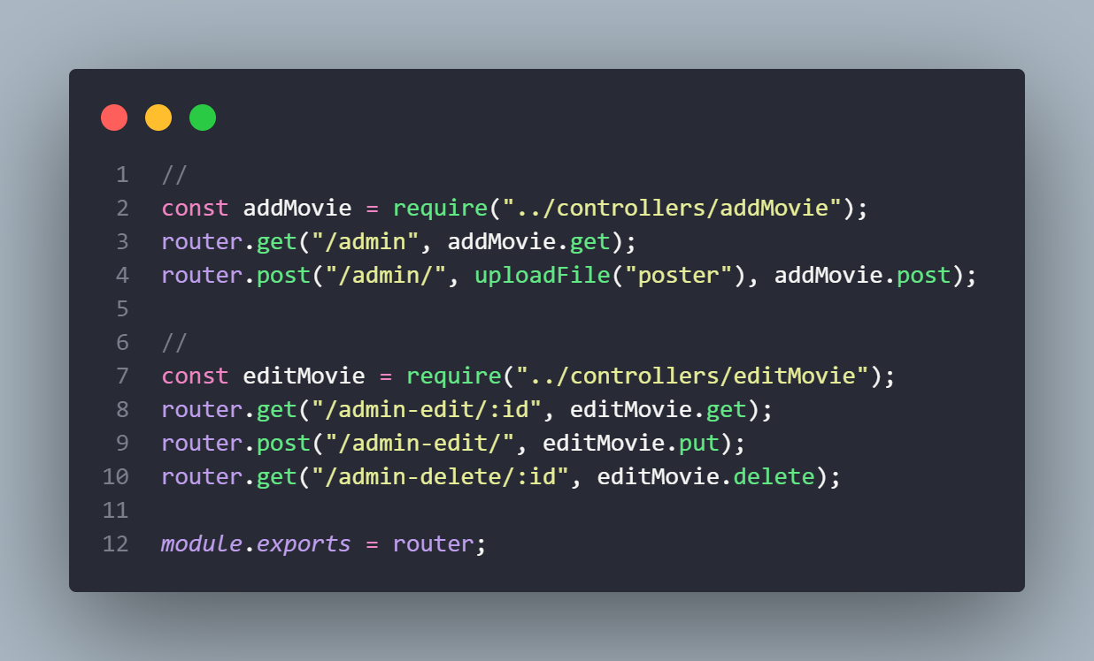
(2)

Slide 11
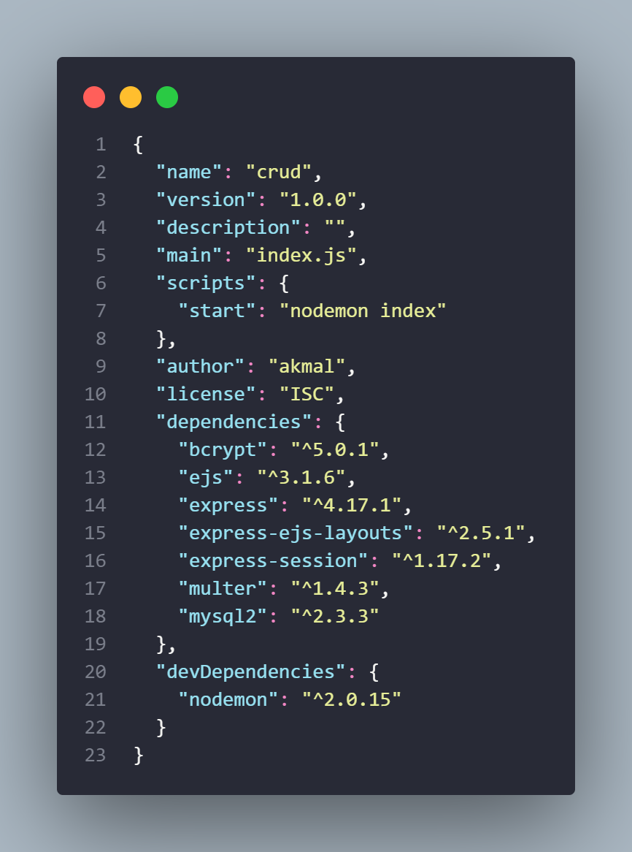
Package.json

Slide 12
Styling using EJS

Slide 13
Integrate to MySQL

Slide 14
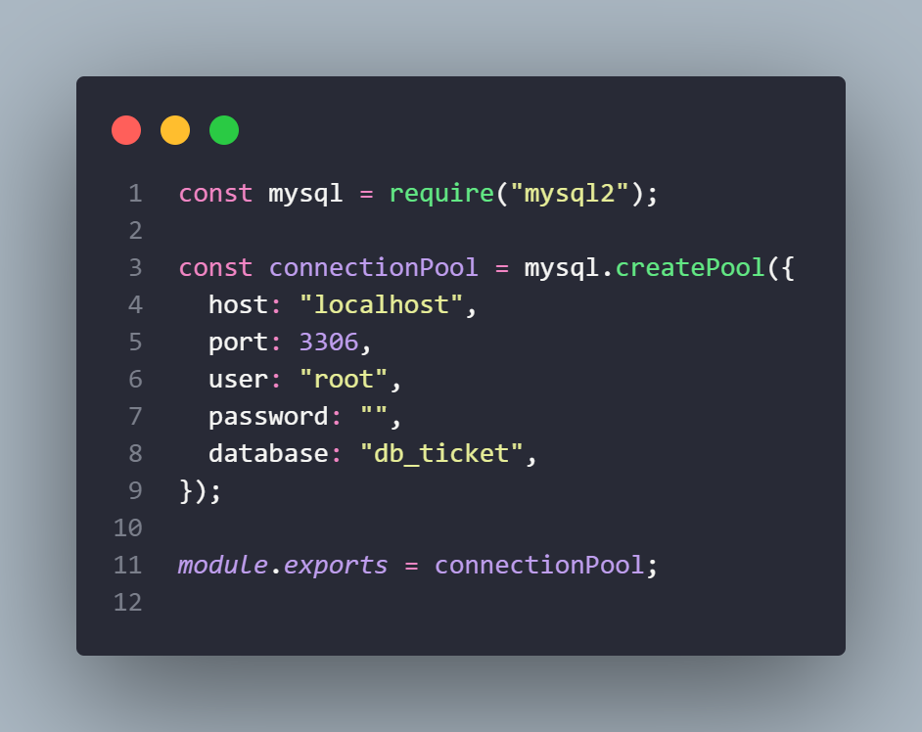
Set up connection to database

Slide 15
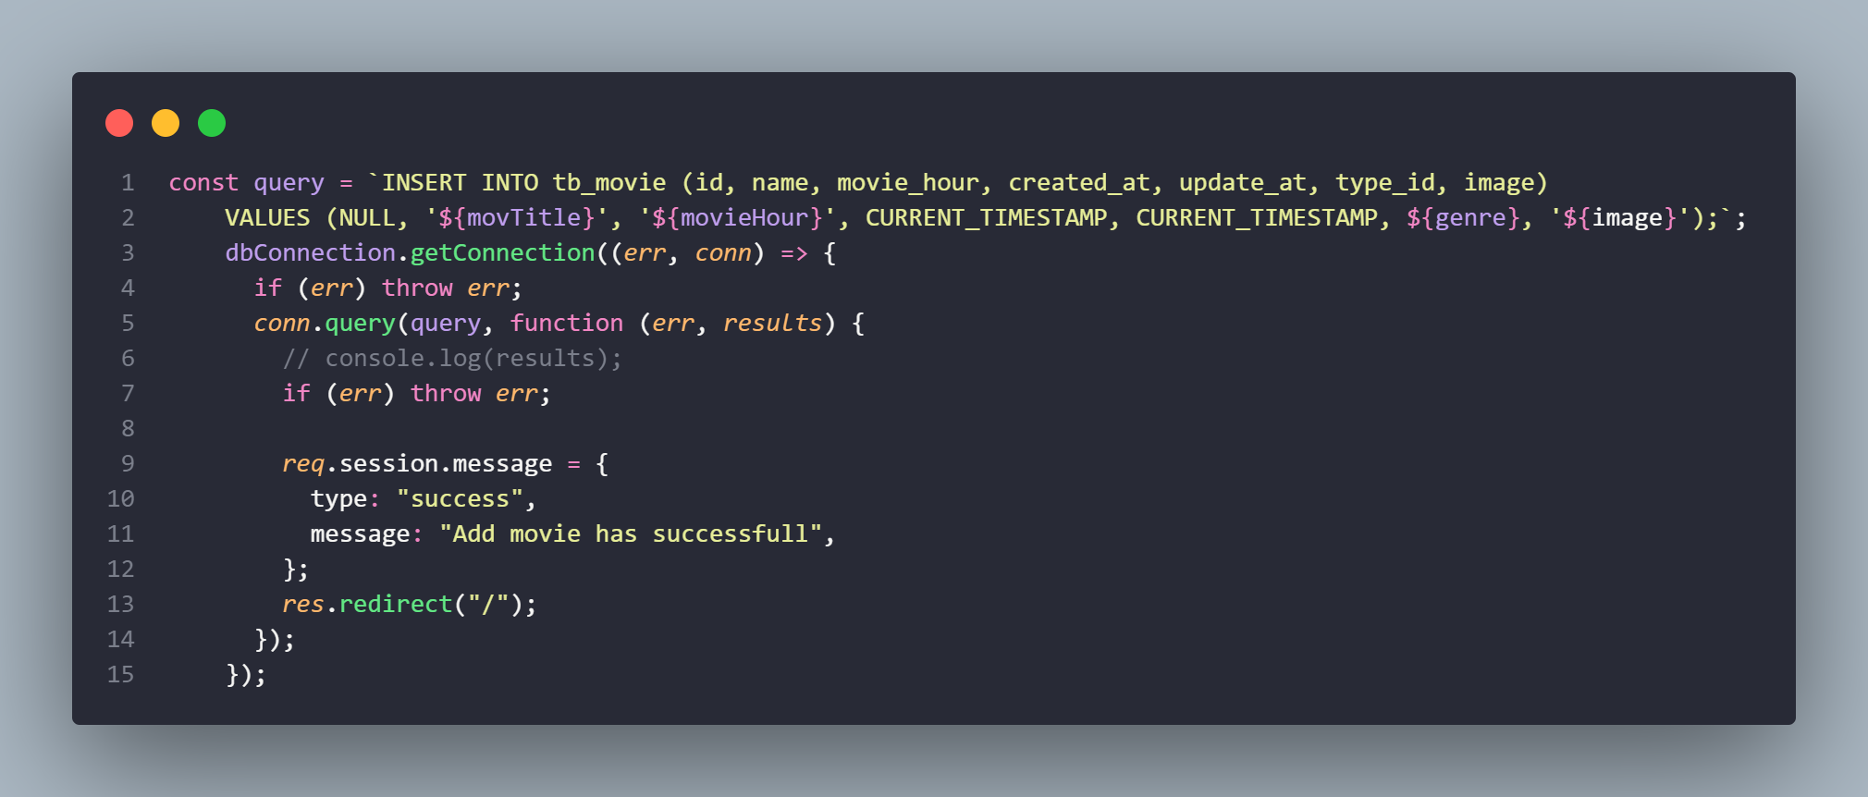
Create

Slide 16
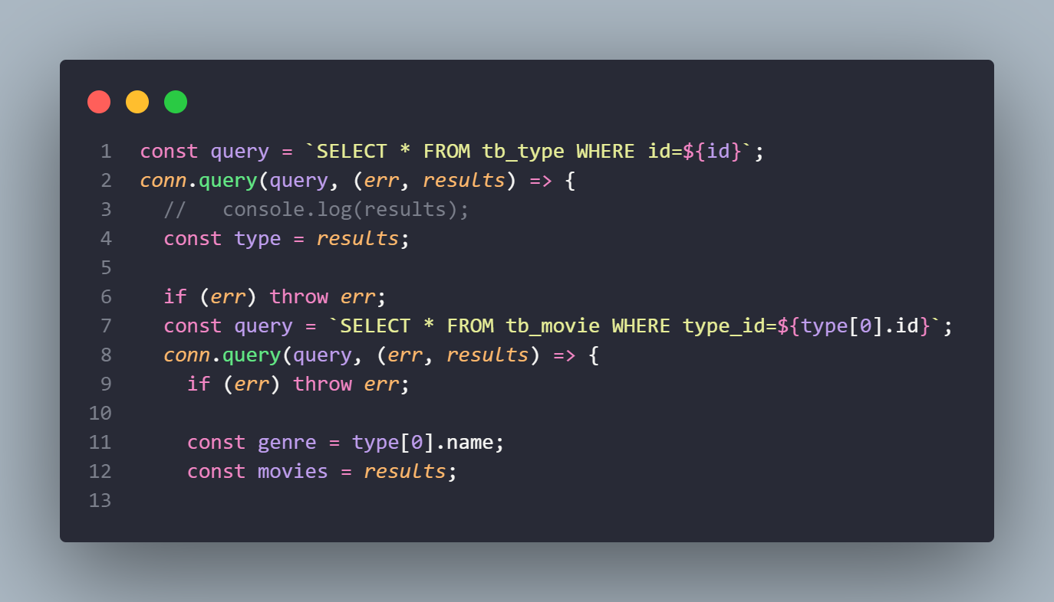
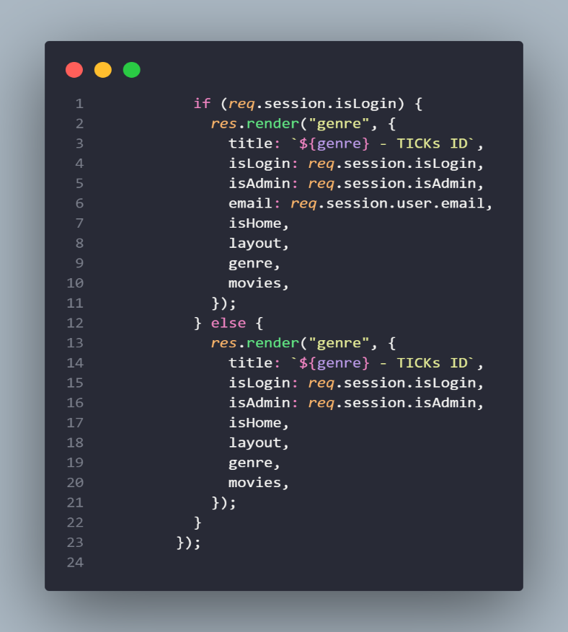
Read

Slide 17
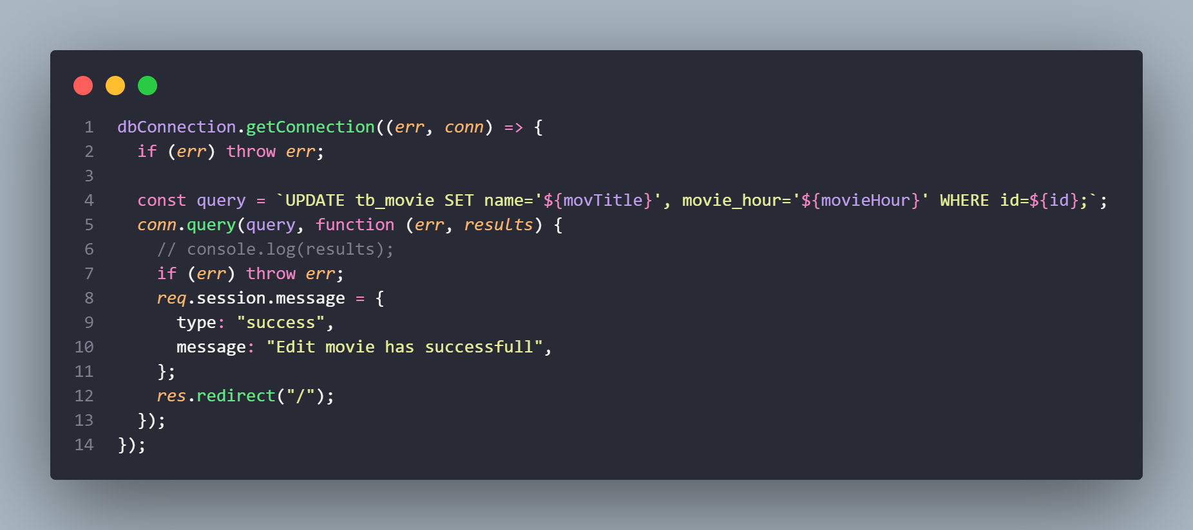
Update

Slide 18
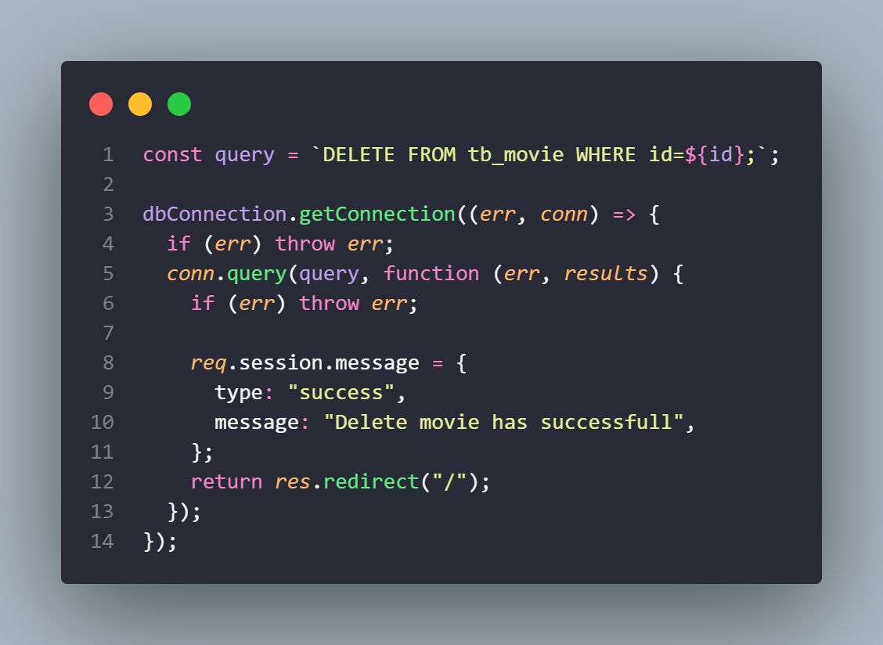
Delete

Slide 19
Thank you
Have a nice day ☺

